Slide 1
Symphony of the Scriptures
Joshua

Slide 2
Joshua
Approx. 1400 BC
Joshua dies 1t 110
Commissioning Conquering Dividing Warning
the Leader the Enemy the Spoil the Victors
Invasion Subjection Distribution The of the land of the land of the land Conclusion
Central Phase One Phase Two Phase Three
Campaign Southern Reuben, Gad, Benjamin-18
The commission - 1 Campaign – 10 ½ Manasseh Simeon,
The spying – 2 Jericho – 6 North Campaign -13- Zebulon,
The Jordan – 3 Loss @Ai–7 & survey – 11 Caleb -14 Issachar,
The memorials – 4 Win @ Ai -8 Summary by Judah-15 Asher, Cities/refuge-20
The consecration – 5 Gibeon – 9 kings – 12 Ephraim-16 Naphtali, Levites 21 Separation -23
½ Manasseh Dan, Civil war Service - 24
Joshua (19) threat - 22
Chapters 1-5 Ch. 8-9 Ch. 10-12 Ch. 13-17 Ch. 18-19 Ch. 20-22 Ch. 23-24
Moses dies -
Whom the “Lord knew face to face”
(Deut. 34:9-12; Josh. 1:1)
Choose God!
Outside Canaan
Promises Given
Conquest - but not completely
Victory - but not total
Main theme
Obedient faith is required and brings abundant blessings
Key Verses
1:8; 24:14-15
Christ in
Joshua
Typified by Joshua, a victorious leader whose name means “Yahweh is salvation”
Notes:
The book of Joshua begins with the death of Moses. His tutorship was critical to Joshua’s success. A quick reading of Deut. 34:9-10 is in order. From Hebrew Yehoshua (God is salvation); The name Jesus comes from a Greek translation of the Aramaic short form “yeshua” which was the real name of Jesus. While Joshua is surely the author it is likely one of his scribes recorded the events around his death (24:29-33). Prominent themes include: first, faith in God, not man, which is demonstrated by the number of manifestations of God throughout the book - solutions only God could bring about (like the walls of Jericho); secondly, obedience to God, underscored in Achan’s story (Chapter 7); thirdly, the faithfulness of God - He keeps His promises, judges His enemies, and preserves His people. The Book divides rather neatly into three parts: entering (Chapters 1-5), conquering (Chapter 5-12), and possessing the land (Chapter 13-24). As we learned in our earlier studies of Numbers and Deuteronomy, Joshua is said to have ”good success” and Caleb “another spirit” with both phrases intended to show the reader that God recognizes the faithful few who will always realize victory when they obey (Nu. 14:24; Josh. 1:8; 24:15; Mt. 7:13-14). We learn from this Book that we must struggle to take hold of the Promise Land - it is not easy. Entering into Canaan would require that the Israelites develop inward character, to be “strong and of good courage” (1:6; Deut. 31:6). This character would show itself in outward manifestations as they spied the land and later conquered it in dramatic fashion. In contrast to the spies Moses sent out, Joshua sends two who come back, having been aided by Rahab the harlot, with a favorable report, “All the inhabitants of the land are fainthearted because of us” (2:24). After God miraculously dries up the Jordan and His people pass over into Canaan and a sign of the covenant is renewed; like Moses, the act of circumcision is done at Gilgal which had its beginning with Abraham (5:2, 9; cf. Gen. 7:10). In a remarkable turn of events God uses another miraculous event to bring down the walls of Jericho resulting in an easy conquest. Joshua 5:10-11 tells us that after they circumcised the males they observed the Passover feast remembering the night they left Egypt 40 years earlier. In this second section Joshua leads his people to the conquest of the opposition while learning that when sin is in the camp defeat will follow - as it did at Ai because of Achan’s sin (6:9). There is victory to the obedient: “Joshua took the whole land, according to all that the Lord had spoken to Moses” (11:12; 12:1 ff.). Having entered and conquered, Joshua leads the twelve tribes in allocation of the land with each tribe receiving a portion: two and one-half on the east side (Gad, Reuben, ½ tribe of Manasseh) of the Jordan and nine and one-half on the west. But not is well as the people fail to keep God’s word by destroying all the enemy and that will plague the Israelites from this point forward (chapter 23).
Application:
Good success was found in Joshua because (see 1:6-8) he had focus, he had a good prayer life, he was active, he persevered, and he prospered.
Victories come in stages; don’t give up too soon - Caleb was 85 when he asked for the area possessed by giants (Caleb - 14:10).
Attitude is essential; don’t ever give up! Stay focused on the objective (Promise Land).
Don’t ever say, I’m not good enough (see Rahab, Heb. 11:31).
Key thought: Not all success is good: the only success that matters is the one that gives us decisive, eternal victory; not temporal prosperity. It’s not what a man has but who he is that counts.

Slide 3
Period | History Covered | Scriptures | Years | Principal
Antediluvian | Creation to the Flood | Gen. 1-7 | 1656 | Adam
Postdiluvian | From the flood to call of Abraham | Gen. 8-!1 | 427 | Noah
Patriarchal | From the call of Abraham to Egyptian Bondage | Gen. 12-45 | 215 | Abraham
Egyptian Bondage | From Egyptian Bondage to the Exodus | Gen. 46-Ex. 11 | 215 | Joseph
Wilderness Wanderings | From Exodus to crossing of the Jordan | Ex. 12-Deut. 34 | 40 | Moses
Conquest of Canaan | From crossing of Jordan to Joshua’s death | Josh. 1-24 | 51 | Joshua
Judges | From Joshua to King Saul | Ju, Ruth, 1 Sa. 1-9 | 305 | Samuel
The United Kingdom | From origin of kingdom to its division | 1 Sa. 9-1 Ki. 11; 1 Chr. 10, 2 Chr. 9 | 120 | David
The Divided Kingdom | From the division to the fall of Israel | 1 Ki. 12-2 Ki. 20; 2 Chr. 10-32 | 253 | Elijah
Judah Alone | From fall of Israel to the fall of Judah | 2 Ki. 21-25; 2 Chr. 10-32 | 125 | Josiah
Babylonian Captivity | From the fall of Judah to the return | 2 Ki. 25-8- 21; Dan. 1-6 | 70 | Daniel
Restoration of the Jews | From the return to end of OT history | Ezra, Nehemiah | 92 | Ezra
Between the Testaments | From end of OT to the beginning of the NT | None | 400 | Judas Maccabee
Life of Christ | From birth of Jesus to ascension | Mt-Jhn 21; Acts1 | 34 | Jesus
The Church | From ascension to death of Paul (96 AD approx.) | Acts 2-Revelation | 70 | Paul

Slide 4
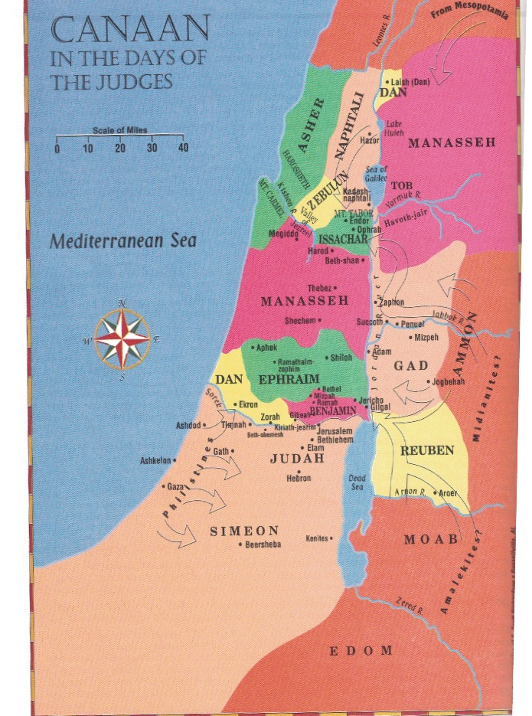

Slide 5
Introduction
“With the burial of Moses, the focus of leadership falls upon Joshua, who will lead the Israelites west across the Jordan River into Canaan---the land first promised to Abraham some 685 years previously. Over the next six years the Israelites will conquer the land and begin to occupy it. However, it will take many more years for the tribes to take full control, and even then many of the local inhabitants will never be driven out. But for now the time has come for Joshua to mobilize the nation…The historical record of Joshua reveals that God has chosen a righteous and courageous leader for His people. Joshua is in almost every respect a forerunner of Christ of One who will one day come to the lead of all true believers into an even greater promised land. The ultimate spiritual Leader will even bear the Greek name which is equivalent to the Hebrew name Joshua (meaning, “God is salvation”). As Joshua is a savior of the nation, this Messiah will be the savior of the world.” --- F. LaGard Smith, The Narrated Bible, page 312

Slide 6
Introduction
“The wilderness-life and the early contests of Israel were over. Israel stood on the threshold of of the promised possession, separated from it only by the waters of Jordan. But, before crossing the boundary-line, it was absolutely necessary that the people should, once and for all, gain full knowledge of the real character of of heathenism in its relation to the kingdom of God. Israel must learn that the heathen nations were not only hostile political powers, opposing their progress, but that heathenism itself was in its nature antagonistic to the kingdom of God. The two were incompatible, and therefore no alliance could ever be formed with heathenism, no intercourse cultivated, nor even its presence tolerated.” --- Edersheim, Bible History - Old Testament, page 13

Slide 7
Who wrote the book?
The book’s primary figure gives it its title. Joshua means “Yahweh saves,” an appropriate name for the man who led Israel, under God’s command, to victorious conquest of the Promised Land. Scholars believe that Joshua himself or a scribe under his direction penned most of the book. Early chapters include firsthand experiences (the NIV uses the pronouns “we” and “us” in Joshua 5:1, 6, for example) and military details worthy of being known and recorded by a general. Joshua 24:26 refers to Joshua writing a portion of the book himself. After Joshua’s death, the high priests Eleazar or Phinehas may have supplemented some material in this book that alludes to events after the conquest (15:13–19; 19:47; 24:29–33).

Slide 8
Where are we?
The events of the book of Joshua span about twenty-five years, starting soon after the death of Moses (Joshua 1:1) around 1406 BC, before the conquest commenced. The conquest of Canaan took about seven years, and Joshua’s final address and subsequent death came almost twenty years later. The book begins with the nation of Israel poised at the banks of the Jordan River, across from Jericho. It records the details of numerous military campaigns that defeated the inhabitants of the land. The book ends with Joshua’s regathering of the nation for his final exhortation.
This history was written to the victorious Israelites who had settled the land. Though they were newly established as conquerors, Joshua reminded them that the conquest was incomplete: “very much of the land remains to be possessed” (13:1).

Slide 9
Why is Joshua so important?
The book of Joshua records the culmination of Israel’s journey to the Promised Land. Here we see God fulfill His promise to give the land of Canaan to Jacob’s descendants. Joshua portrays the Lord as their general, the One who would lead His people in victorious battle if they would trust and obey.
Joshua recounted a story of contradictions. On the one hand, God gave the land that He had promised to the nation. On the other hand, the people failed to possess the land completely, allowing some inhabitants to remain. God fulfilled His side of the bargain, but the Israelites did not finish the job. The Canaanite peoples became a damaging influence on Israel as years went by.
In this book we find accounts of faithfulness: Rahab the harlot (Joshua 2:1–21), the battle of Jericho (6:1–27), and Caleb the warrior (14:6–14). We also witness disobedience and its consequences: Achan’s sin (7:1) and the resulting loss at Ai (7:5), failure of some tribes to annihilate the enemy as God commanded, and even Joshua making a treaty with the Gibeonites without first seeking the Lord (9:1–27).

Slide 10
What's the point?
The book of Joshua was written to the descendants of those who conquered the land, as a historical account of how they had come to settle there. It celebrates God as general, defender, and king. It shows the geographical boundaries given to each tribe of Israel. Even more significantly, the book of Joshua serves as the connecting narrative between the days of Moses and the days of the judges, during which the book was first circulated. That which Moses began and endured in the wilderness, Joshua was able to claim victoriously in the land. God’s promises through the ages were being fulfilled before the people’s eyes. “Not one of the good promises which the Lord had made to the house of Israel failed; all came to pass” (21:45).

Slide 11
How do I apply this?
Memory is a gift. Remembering the past teaches us countless lessons about how to live today. The Israelites forgot. They did not remember the miraculous events that brought them to their land or the covenant that united them to their God. But God did not forget His covenant—and because of His great love for His people, He disciplined His sinful children so that they might return to Him.
Have you forgotten the great works God has done in your life? Perhaps your difficult circumstances are overpowering your faith. Do you feel as if He is disciplining you right now? Know that He disciplines those He loves (Hebrews 12:5–11). Return to Him. Remember, trust, and obey. He is waiting with open arms.

Slide 12
Brief Outline
I. The land entered, Chapters 1-12
A. Commission and command of Joshua (1)
B. Contact of spies with Rahab (2)
C. Crossing the Jordan River (3)
D. Construction of two memorials (4)
E. Conditioned for conquest (5)
F. Center of land attacked (6-8)
1. Conquest of Jericho (6)
2. Conquest of Ai (7, 8)
G. Campaign in the south (9, 10)
1. The Gibeonite deception (9)
2. Conquer 5 kings of Amorites (miracle of sun) (10)
H. Campaign in the north, (conclusion of Joshua’s leadership in war) (11)
I. Conquered kings listed (12)
II. The land divided, Chapters 13-22
A. Command of Joshua is terminated; confirmation of land to the 2 1/2 tribes (13)
B. Caleb given Hebron (14)
C. Consignment of land to the tribes of Israel (15-19)
D. Cities of refuge (20)
E. Cities for Levites (21)
F. Command to the 2 1/2 tribes to return home; construction of altar as a witness (22)
III. The last message of Joshua, Chapters 23, 24
A. Call to leaders of Israel for courage and certainty, Jos 23
B. Call to all tribes of Israel for consecration and consideration of covenant with God; death of Joshua ( 24)

